Slide 1


Big Mountain Resort
Executive Management presentation on price data modelling – December 2022
Jonny Pearce

Slide 2
Problem identification
Context
Big Mountain Resort (BMR) – great Montana ski resort, with market-leading ski features, inc:
Location – the beautiful Glacier National Park/ Flathead National Forest
Hellfire ski run
High elevation and large vertical drop
Access to 105 trails.
Recent installation of extra chair lift to increase visitor volumes at an additional operation cost of $1.54m per season.
However, current pricing strategy based on charging a premium over the average price for the business’ market segment, but there are concerns this doesn’t fully account for the value and features that the business has or that it could further exploit.
In short, our problem is we don’t know truly what we’re worth, and maybe underselling ourselves.
Our challenge
“Develop a ski-resort-features-based pricing model (using features such as number of runs, skiable area and lift capacity) that compares assessed value of US ski resorts by market sector and makes recommendations on ticket-pricing for the Executive Management Team, by the end of the summer (ahead of the start of the annual marketing cycle).”

Slide 3
Problem identification (2)
Success criteria
Meaningful comparisons – understanding like-for-like or similar value-propositions within the US ski resort sector.
Delivering a pricing model for Executive Management Team to make informed decisions about future pricing and investment.
Estimating potential for increase in customer numbers and ticket pricing, so as to maximise profitability and market share.
Constraints
More information needed on other areas of cost-cutting or future development, to better understand scope for assessing value of those initiatives and how they impact visitor numbers/experience.
Need more detailed market research some on actual versus perceived “customer value”.
Need more financial information to fully measure impact of pricing proposals on profit margins.
Distilling most useful data from our datasets.
Not clear if night-skiing data will be available.
Stakeholders
Jimmy Blackburn – Director of Operations; Alesha Eisen – Database Manager; VP Marketing; CFO; VP Human Resources; Executive Management Team

Slide 4
Recommendations
Further exploration should be carried out on scenario 2 (increasing vertical drop by adding a run to a point 150 feet lower down but requiring the installation of an additional chair lift, without additional snow making coverage), with additional investigation of the cost savings from closing up to 5 runs. The c$1.5m cost of investing in a new chair lift would be more than covered by the additional revenue from an additional run, by a factor of 2:1.
Additional information and data on the following should be gathered and applied within the further exploration above:
other price-related issues for ski visitors, such as any hire costs, additional pricing and average spend while at the individual resorts.
the operating costs per visitor, and any necessary investment that would be required to manage increased numbers.
Information on segmentation of visitors would be useful or consideration of whether this is an opportunity, eg, having differential pricing for those visitors who take advantage of the main features of BMR compared to those who don't, eg, novices versus experience, young versus older skiers, etc.
more information on visitor number and the spread or distribution of these re skiable days across the sector as a whole, along with more information on visitor demographics, and how visitor numbers fit with the catchment areas represented by each region (eg, how far on average to do people travel for skiing visits/holidaying?).
Based on the above, explore some of BMR's nearest competitors to assess their pricing strategies, and understand any sensitivities on increasing prices and the impact on market share. BMR's pricing is already relatively high in the sector, and there may only be scope to increase prices if market leading features are retained and enhanced.

Slide 5
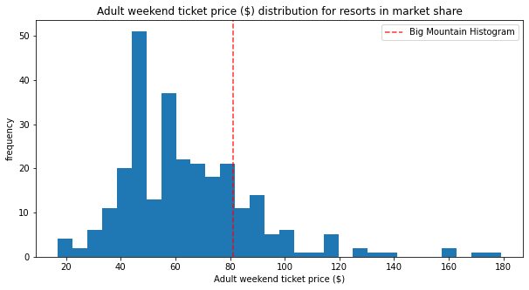
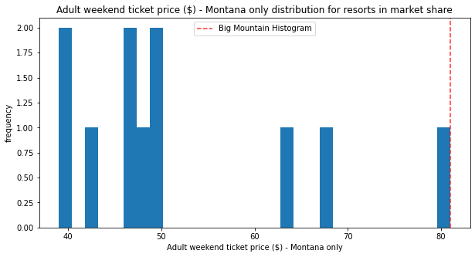
Where do we fit in the market?
Ticket prices
Nationally - Towards the higher end of the market ticket pricing, but by no means the highest.
State-wide – top-end; highest price.
Issues to consider
Increases in ticket likely to need justification within local/regional markets based on introduction of additional market-leading features?
For national markets, more lassitude for price increases comparative to other resorts?

Slide 6
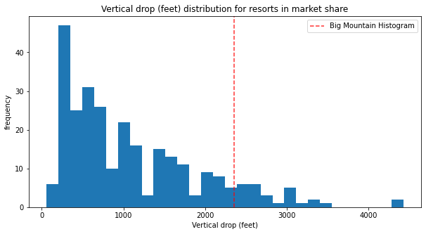
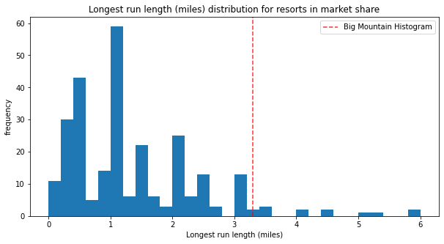
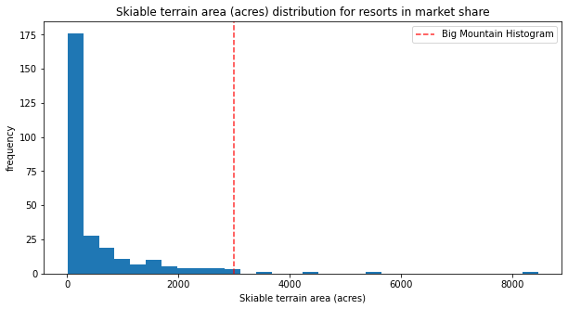
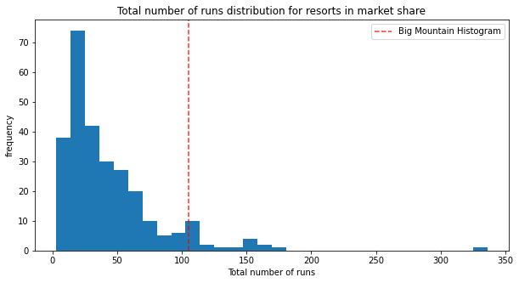
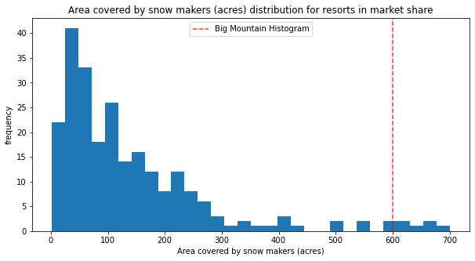
Key marketable features(1)
BMR really stands out for our natural features:
Vertical drop
Snow coverage
Number of runs
Longest run
Skiable terrain

Slide 7
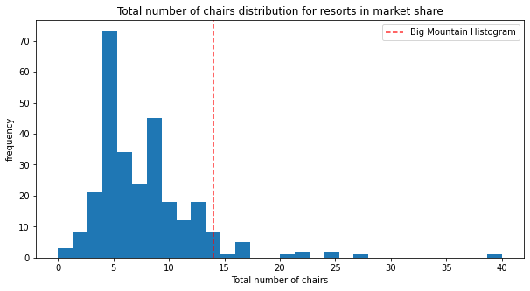
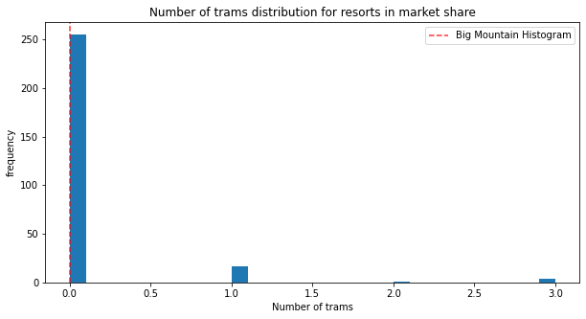
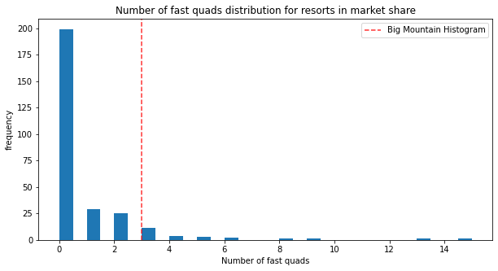
Key marketable features(2)
… and also our “built” features/access features (ie, our skiers need these to access our natural market-leading features):
Chairs
Quads
… but Trams are irrelevant

Slide 8
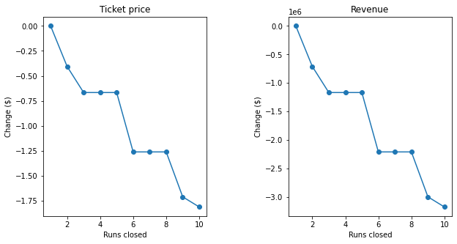
Modelling results
Scenario 1 (Close up to 10 of the least used runs)
Closing 1 makes no difference, closing 2 and 3 reduces support for ticket price/revenue, but if we close down 3, might as well close 4 or 5.
Scenario 2 (Add a run, increase vertical drop by 150 feet, install new chair lift)
Increases support for ticket price by $1.99; increases seasonal revenue by c£3.5m.
Scenario 3 (Same as 2, but add 2 acres of snow coverage)
Such a small increase makes no difference
Scenario 4 (Increase longest run by 2 miles and guarantee snow coverage by additional 4 acres)
Makes no difference whatsoever.

Slide 9
Summary/conclusions
Our key marketable assets are the resort’s natural features (vertical drop, runs and their length), combined with the ability of our ski visitors to access them (chair lifts).
Scenario 2 is recommended for further exploration, inc additional investigation of the cost savings from closing up to 5 runs. Investing in chairlifts in covered by additional revenue by a factor of 2:1.
Refine modelling system and trial/roll-out to managers, with training.

